Slide 1
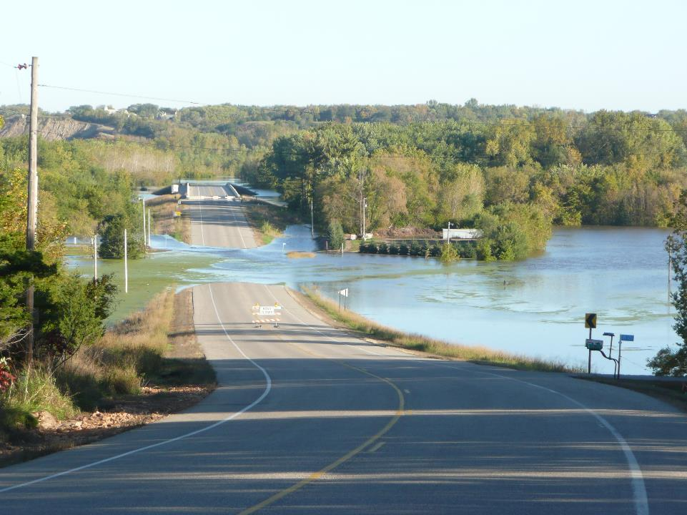
USGS Streamgaging and Sediment Monitoring in MN
James Fallon
U.S. Geological Survey
jfallon@usgs.gov
763-783-3255
Legislative Water Commission
Sept. 17, 2018
Notes:
Chair and commission members,
Thank you for opportunity to present some of the work we do at the USGS and collaboratively with other agencies
Seemed like a fitting picture because it captures many of the issues Mr. Stark asked us to present today
Photo is of the Minnesota River north of Jordan, Sept, 29, 2010
Our streamgage here recorded the 7th highest peak (74,700 cfs) of record (117K, since 1934),
1 of only 2 annual peaks to occur as late in year as Sept. (other was 2016)
Unusual severe fall flood that seems more common in past 8-10 years.
From foreground to background looking north, you see
Infrastructure closed due to flooding over roadway
Main bridge with streamgage on main channel
About a mile of flow over road to north and flow thru heavily cropped corn field on dss of road, a common contributor to sediment in streams
Bluff erosion (here, not related to river flow), but has been found to be a common contributor to sediment loads in streams
Finally, the unusual late season flood flowing through dense peak foilage essentiall slows and backs up the river causing large shifts to flow we measured at gage.
This resulted in much concern by the NWS in their flood forecast downstream in the Mississippi River at St Paul.
I’ll try to touch on those issues and others in this presentation.

Slide 2
Presentation Topics
How streamgaging and sediment information fits together? How is information used?
Brief history of streamgaging & sediment
USGS streamgaging process
“Rating curve” is the Rosetta Stone
Streamflow fundamental to sediment studies
Sediment studies in MN
Use of streamgage and sediment information by state entities

Slide 3
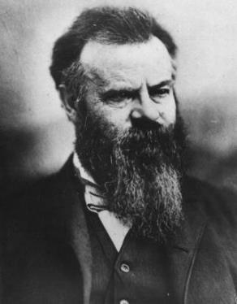
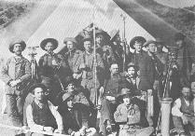
USGS and streamflow
1860s-70s: development of west
A “USGS” proposed to survey geologic & economic resources
Powell recognized water was most valuable resource; needed inventory
1st USGS streamgage in Embudo, NM in 1889
Established training center for engineers in art of streamgaging
John Wesley Powell
Director of USGS
Notes:
1860s-70s: development of West
Eastern farmlands losing fertility
Industrial developmt needed resources
Western US being settled
“USGS” was proposed to study west’s geologic & economic resources
Powell led surveys of west for geology & paleontology
The Mississippi River at Grand Rapids has the longest continuous record of daily discharge in the state, beginning September 17, 1883. The second longest record is from the Mississippi River at St Paul, which began March 1, 1892. More information about the history of the streamgage at St Paul is noted in USGS Scientific Investigations Report 2014-5079. Additional active streamgages with continuous daily discharge records that began more than 100 years ago include the following. Note that some may have gaps in their records.
04024000 St Louis River at Scanlon*
05078500 Clearwater River at Red Lake Falls*
05079000 Red Lake River at Crookston
05131500 Little Fork River at Little Fork*
05132000 Big Fork River at Big Falls
05211000 Mississippi River at Grand Rapids
05244000 Crow Wing River at Nimrod*
05270500 Sauk River near St Cloud
05275000 Elk River near Big Lake*
05280000 Crow River at Rockford*
05291000 Whetstone River near Big Stone City*
05300000 Lac Qui Parle River near Lac Qui Parle*
05316500 Redwood River near Redwood Falls*
05317000 Cottonwood River at New Ulm*
05325000 Minnesota River at Mankato
05331000 Mississippi River at St Paul
05355200 Cannon River at Welch
05457000 Cedar River near Austin
05476000 Des Moines River at Jackson

Slide 4
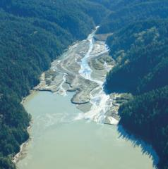
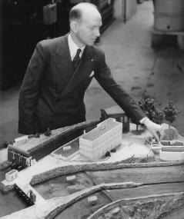
Sediment monitoring more recent
Design of large reservoirs for irrigation, hydropower, flood control:
Life of reservoirs due to sediment deposition
Streamflow and sediment load
Sediment sites in MN reflected that demand
Fed. Interagency Sediment Project developed standard methods & samplers.
Much of development and testing done at St Anthony Falls Laboratory, MN
SAFL Director Straub
Notes:
1940-50s: US designing large reservoirs for irrigation, hydropower, flood control, required information about
Fed. Interagency Sediment Project developed standard methods & samplers. USGS, USACE, USDA, BLM, BoR, USFS, EPA.

Slide 5
What the USGS does
An independent science agency that collects, monitors, analyzes, and provides scientific understanding about natural resources and natural hazard conditions.
Value of USGS to Nation rests on its ability to carry out studies on a national scale and to sustain long-term monitoring and assessment of resources and hazards.

Slide 6
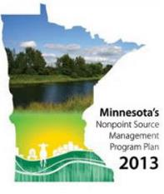
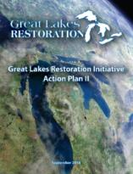
USGS Water Science Centers
Maintain scientific relevance by collaborating with our stakeholders and cooperators
Align cooperator science needs, management, and strategic plans with USGS science priorities

Slide 7
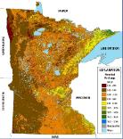
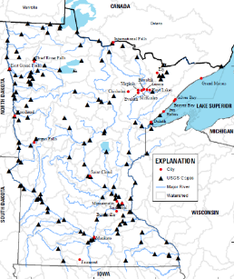
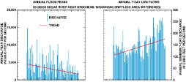
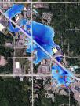
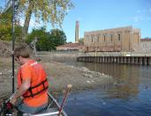
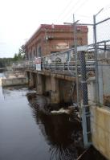
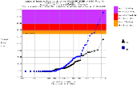
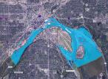
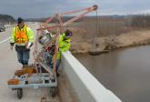
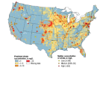
Hydrologic Monitoring
Collecting data that are accurate, reliable, unbiased, consistent & timely is the foundation of everything we do.
Trends in floods………………and low flow
Flood documentation
GW Recharge analysis
Flood forecast support and flood-inundation mapping
USGS MN Streamgage Network
Water supply
Hydropower regulation
Low-flow frequency analysis
Flood frequency
Sediment and bedload
Water Quality

Slide 8
How high? Low? How much? When? How frequent? Trends?
Streamflow Monitoring
in the USGS
Notes:
How high? Low?-→water level or stage How much? →streamflow rate, inches of runoff When? → when did event occur? When are typically wettest or driest periods? How frequent?→ how often can expect to get flooded out/will my water intake run dry Trends? Is it getting wetter? Drier? Do we have enough water for more development? More frequent floods? More severe floods? More days above flood stage?

Slide 9
Streamgaging Is a Partnership
USGS & local partners fund streamgages
USGS:
Operates & maintains gages
Makes field measurements
Processes, QAs, publishes & archives data
Feeds data updates to NWS, COE, etc
Integrates data into other studies
Local partners (& others) use data for their needs
NWS uses data for forecasting

Slide 10
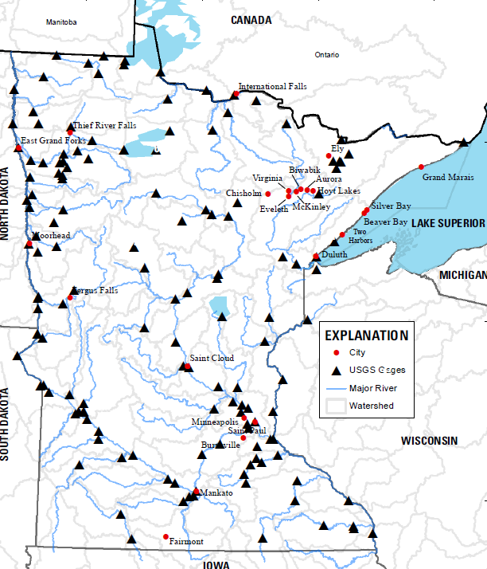
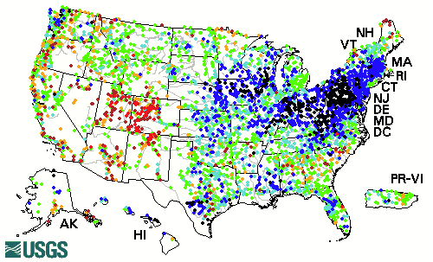
USGS Streamgage Network in MN
125 real-time streamgages
Funded by USGS &
>40 other entities
Federal
State
Regional
County
City
Tribe
Hydropower
Notes:
Streamgage Network is national,
This is number in MN. Presentation only about these. DNR & local cooperators have others.
Streamgage process briefly so Ratings Depot makes sense

Slide 11
Streamgage Funding Sources, MN
Notes:
Includes all streamgages, CSGs, low-flow network, etc.
About $2.01M FY12
Explain NSIP
Next slide is funding breakdown ONLY for continuous streamgages (about 103 in Minnesota)
Source T:\DataSection\StatusOfDataSection\DataSectionStatus\Gaging_station_program_trends_MN.xlsx

Slide 12
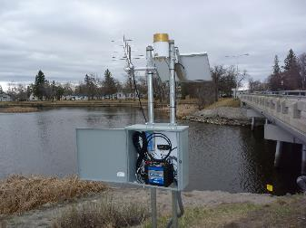
Two components of data needed for basic streamgaging
Stage of stream
“gage height” or “river level”
Streamflow or discharge
volume of water flowing in the river past a given location, as rate
Notes:
Walk through slide concepts
Ideally, we want these data continuously because streamflows change continually and often rapidly
…so how do we measure these things?

Slide 13
Stilling well streamgage
Notes:
Currently there is no economical way to continuously measure discharge, so we have to develop a relationship between the two components:
stage and discharge.
This is an older style gage that is used to measure stage and is still the gold standard for accuracy, still in use today, to illustrate gage process.
A well is dug into streambank and connected hydraulically to stream with galvanized pipes.
When stream rises and falls, the water level in well does same.
The float on the wells water surface moves up and down, moving the tape connected to a recorder.

Slide 14
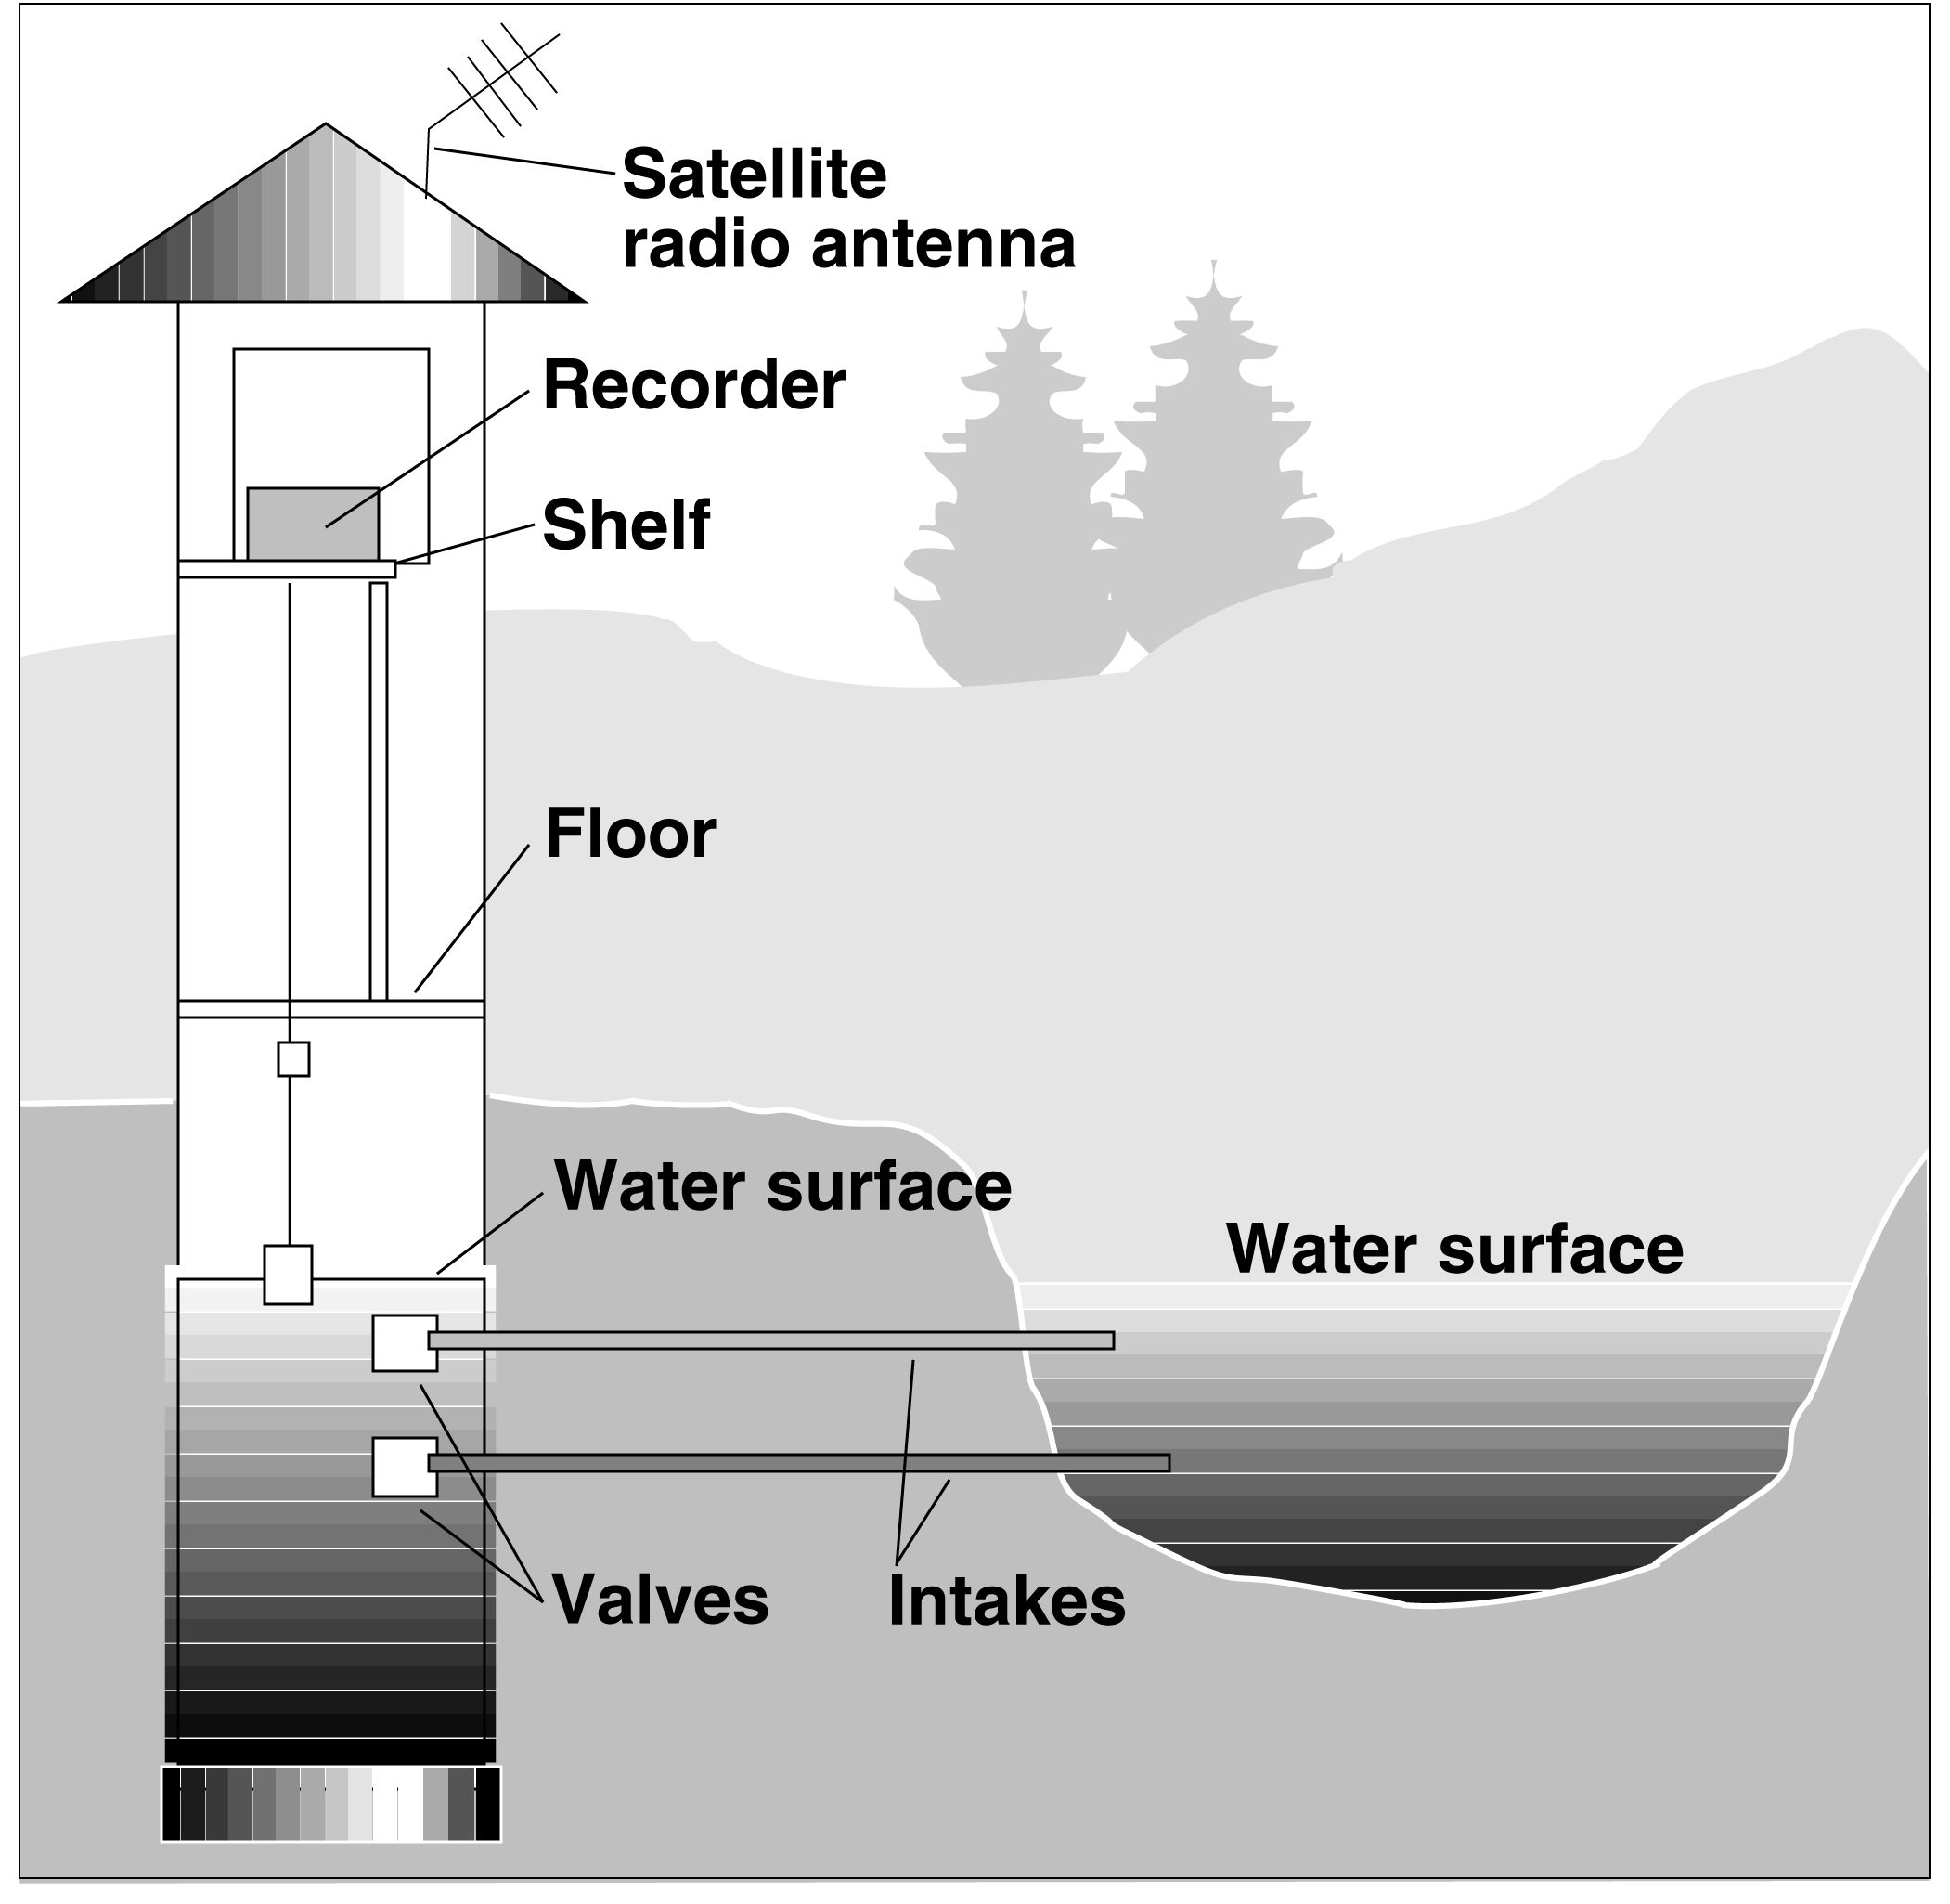
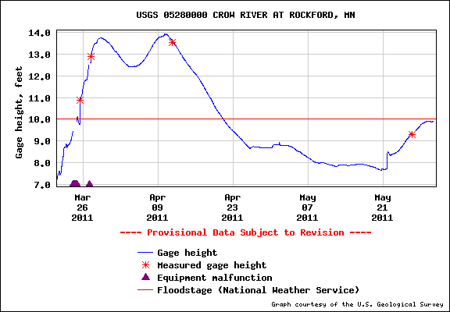
Streamgaging Process ~ 1
Continuously record stage
USGS
Notes:
In MN, the stage data is recorded every 15 minutes and transmitted every hour, typically to a NOAA GOES satellite.
The stage data are downloaded to our computers, continually QA’d and posted to public web

Slide 15
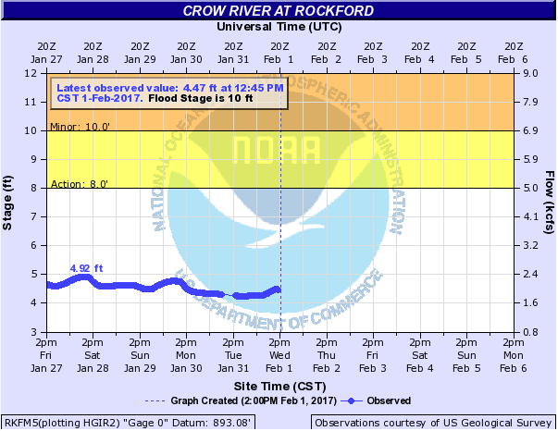
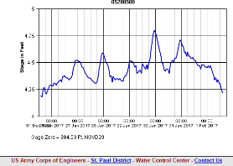
Streamgaging Process ~ 2
Continuously record stage
USACE
NWS
USGS
Notes:
The tage data also are being simultaneously downloaded by the NWS & COE for their operations

Slide 16
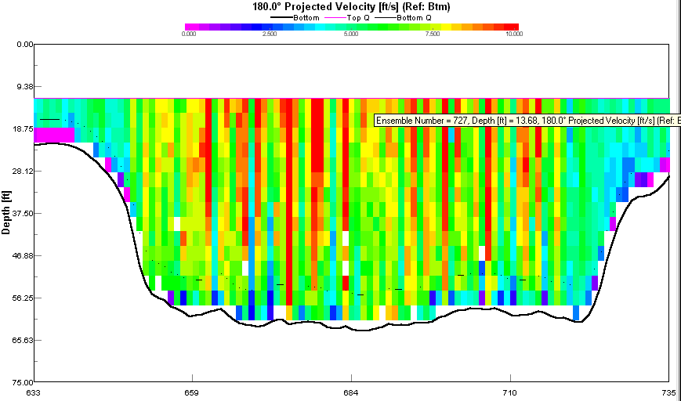
Streamgaging Process ~ 3
Continuously record stage
2. Frequently
visit site to physically measure discharge
Notes:
So that is stage, how do we determine the discharge?
Periodically, about every 6-8 weeks and during high and low-flow events, our hdrographers visit the gage
to (1) verify and measure the stage independently, and (2) make a direct, physical measurements of discharge.
Now we have a paired observation of stage and discharge for a given flow
Repeating this process every 6-8 weeks and during high and low-flow events allows us to

Slide 17
Streamgaging Process ~ 4
Continuously record stage
2. Frequently
visit site to measure discharge
3. Develop & maintain
stage-discharge relation
Discharge Measurements
Rating Curve
Notes:
Develop a relation between stage and discharge
It’s not a static relation because rivers continually scour and fill, some worse than others.

Slide 18
Streamgaging Process ~ 5
Continuously record stage
Channel fill
Stage-discharge relation (rating)
Causes negative shift
to rating
Notes:
Channel fill causes negative shift to rating
Shift can only be defined by additional discharge measurements (brown circles)
Other negative shifts: algae, leaves on control, grass growing in channel, ice, beaver dams, etc
We use shifts when conditions are considered TEMPORARY
If relatively permanent, we will develop a new rating

Slide 19
Streamgaging Process ~ 6
Continuously record stage
Channel scour
Stage-discharge relation (rating)
Causes positive shift
to rating
Notes:
Channel scour causes positive shift to rating
Shifts can only be defined by additional discharge measurements (blue circles)
Note that this shift is in the middle of the rating because feature in cross-section that caused it is higher up. No effect to low-flow.
Positive shifts generally caused by scour of channel bottom, bank slough, major re-route of channel (new rating)

Slide 20
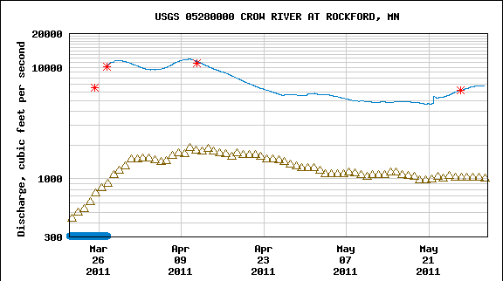
Streamgaging Process ~ 7
Continuously record stage
2. Frequently
visit site to measure discharge
3. Develop & maintain
stage-discharge relation
Discharge Measurements
Rating Curve
4. Analyze, correct, compute, review, & serve data to public
Notes:
Process is repeated because
We need to accurately define the entire range of stage & flows that occur
Most river channels continuously shift, so relation between a given value of stage and the discharge changes
Public & emergency planners need most accurate flows available for modeling, forecasting, emergency planning
USGS efforts ensure the most accurate available at all gages—that is one place where collaboration occurs:
& ensure everyone has access to same data at same quality at same time; part of mission
These data also serve as foundation for many other uses that I’ll discuss

Slide 21
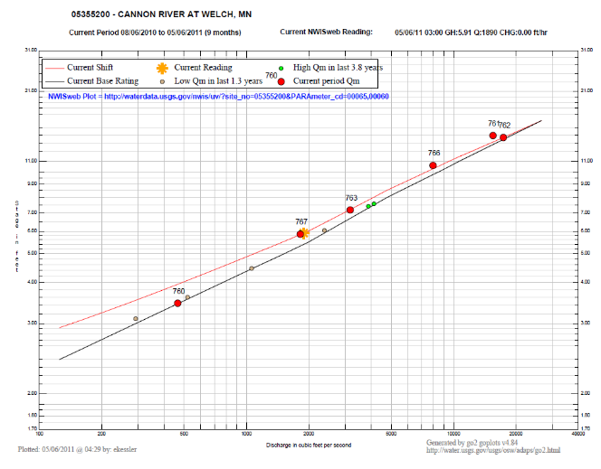
USGS and NWS use rating curves in fundamentally different ways! ~ 1
USGS uses recorded stage to calculate discharge that passed
Start
Stage
Discharge
End
Notes:
I mentioned the rating curve is the Rosetta Stone. Here’s what I mean by that:
As just explained, USGS uses recorded stage to calculate the discharge that has occurred (so stage to predict discharge)

Slide 22
USGS and NWS use rating curves in fundamentally different ways! ~ 2
The NWS models rain & snowmelt runoff (and data from upstream gages) to estimate how much water will pass your site, then uses rating to predict river’s peak
End
Stage
Discharge
Start
Notes:
The NWS has a different mission in forecasting floods:
Given the amount of flow in the stream, and their model predictions of rainfall or snowmelt, the estimate how much water will pass your site
Then use the stage-discharge rating to predict the stage (flood level)

Slide 23
State entities known* to use streamgage data
DNR
DOT
MPCA
HSEM
BWSR
MDA
MDH
EQB
Commerce Dept
MN Geological Survey
University of MN, MNSCU
Science Museum of MN
Pipeline Safety
Public Safety Department
Tourism
State & Federal legislators
Metropolitan Mosquito Control District
Metropolitan Council Environmental Services
Directly fund streamgages, currently or recently
*USGS doesn’t always know who uses our data, only those who contact us
Notes:
DNR
Permitting, water allocations, well head protection
Fisheries & restoration
Climatology office
DOT
Flood frequencies to design bridges & culverts
Monitor scour
MPCA
WQ impairments and assessments
HSEM
Flood mitigation and documentation
BWSR
MDA: pesticide and nutrient monitoring and transport
MDH:
Contaminant transport
Climate adaptation planning
EQB: reports
Commerce Dept: flood documentation
MN Geological Survey: products
Met Council Environmental Serv.
Metropolitan Mosquito Control
When and where to treat
University of MN, MNSCU: research
Science Museum of MN: research
Pipeline Safety
Public Safety Department
Tourism
State & Federal legislators

Slide 24
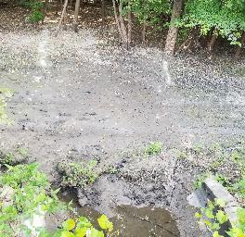
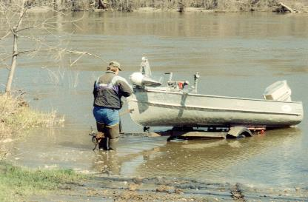
Sediment monitoring and streamgages
Why renewed need for sediment monitoring?
Why is streamgaging needed?
Sediment deposited on flood recession
Notes:
So we’ve covered streamgaging, why do we monitor suspended sediment and why do we need streamgaging for it.

Slide 25
“Sediment” Network
Types of monitoring
Discrete sampling
Suspended sediment
Bedload
Continuous monitoring
Turbidity
Hydroacoustic backscatter
Funding
MNDNR
MN LCCMR
USACE
Lower MN River Watershed District
Notes:
For the purposes of this talk, I’m just going to refer to “sediment” unless being specific.

Slide 26
Why the renewed need for suspended sediment monitoring?
Turbidity
New science questions
Impairments and regulation
Understanding stream processes for
Reducing impairments
Suspended material
Contaminants associated with suspended material
Maintaining or restoring aquatic habitat
Planning channel maintenance
Total suspended solids
Suspended sediment
Bed load sediment
Notes:
2009 MPCA promulgated turbidity standard
2014 MPCA promulgated TSS standard
For several different reasons, neither turbidity nor TSS are sufficient for understanding stream processes, impairments,
Turbidity, a measure of water clarity is
Proficiency: good for understanding the amount of light and vision that is available to aquatic plants and animal
Deficiencies:
there are many definitions and ways of measuring (apples & oranges)
It is a physical characteristic of the water, not a direct measure of what is in (being transported by the water)
TSS, is a partial measure of what stream is transporting, and r
Proficiency: relatively good for assessing contaminants associated with fine-grained silt and clay sized material that float a while in water, like phosphorus and some organics.
Deficiencies:
analytical results not very robust; dependent on techniques of analyst and person sampling
not representative of all that is being transported due to how it is sampled and how it is analyzed.
Suspended sediment concentration (and percent fine-grained material) is a measure of what entire stream is transporting
Proficiencies:
assessing contaminants associated with fines that float a while in water, like phosphorus and some organics.
assessing fouling of stream habitat due to sedimentation
assessing
Deficiencies: not representative of all that is being transported due to how it is sampled and how it is analyzed.

Slide 27
Why is streamgaging needed for sediment monitoring? ~ 1
TSS & SSC measurements provide snapshots of concentration.
Without streamflow, concentrations alone:
Don’t tell us how much is being transported
Can’t tell us about process-related trends**
Can’t compare streams and basins
Can’t address Total Maximum Daily Loads (TMDLs)*
√
√
√
Notes:
Knowing suspended sediment concentrations without knowing streamflow rate is like knowing your bank account balance without knowing how much you’ve been spending
*A load is the mass of a contaminant, so a daily load is a rate. A rate transported by a river requires streamflow.
**For example, let’s say we observe TSS or SSC concentrations decreasing 10 years on a river. We must

Slide 28
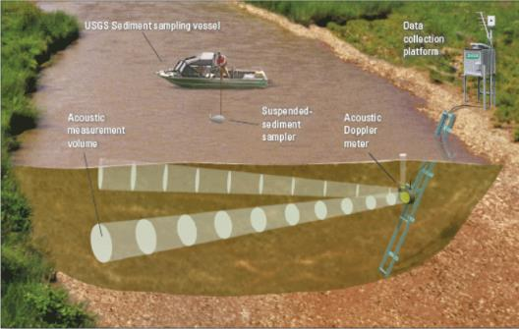
Why is streamgaging needed for sediment monitoring? ~ 2
Co-locating sediment monitoring at streamgage
Simplifies logistics
Provides equipment and instrumentation to improve the quality and continuity and completeness of sediment transport
Notes:
Knowing suspended sediment concentrations without knowing streamflow rate is like knowing your bank account balance without knowing how much you’ve been spending
*A load is the mass of a contaminant, so a daily load is a rate. A rate transported by a river requires streamflow.
**For example, let’s say we observe TSS or SSC concentrations decreasing 10 years on a river. We must

Slide 29
The ultimate marriage of real-time streamflow and sediment monitoring

Slide 30
State entities using sediment data, or benefit from understanding
DNR
MPCA
DOT
HSEM
BWSR
MDA
MDH
EQB
Commerce Dept
MN Geological Survey
Met Council Environmental Services
University of MN, MNSCU
Science Museum of MN
Tourism
Directly fund sediment studies, currently or recently
*USGS doesn’t always know who uses our data, only those who contact us
Notes:
DNR
Fisheries & restoration
MPCA
WQ impairments and assessments
LCCMR
DOT
Flood frequencies to design bridges & culverts: sediment clogs culverts, causing costly road washouts
Monitor scour
HSEM
Hazard mitigation bank erosion processes
BWSR
(water and soil = suspended sediment)
MDA: pesticide and nutrient monitoring and transport
MDH: contaminant transport
EQB
Commerce Dept: flood damage
MN Geological Survey: fluvial processes
Met Council Environmental Serv: Understand processes
University of MN, MNSCU
Science Museum of MN
Tourism

Slide 31
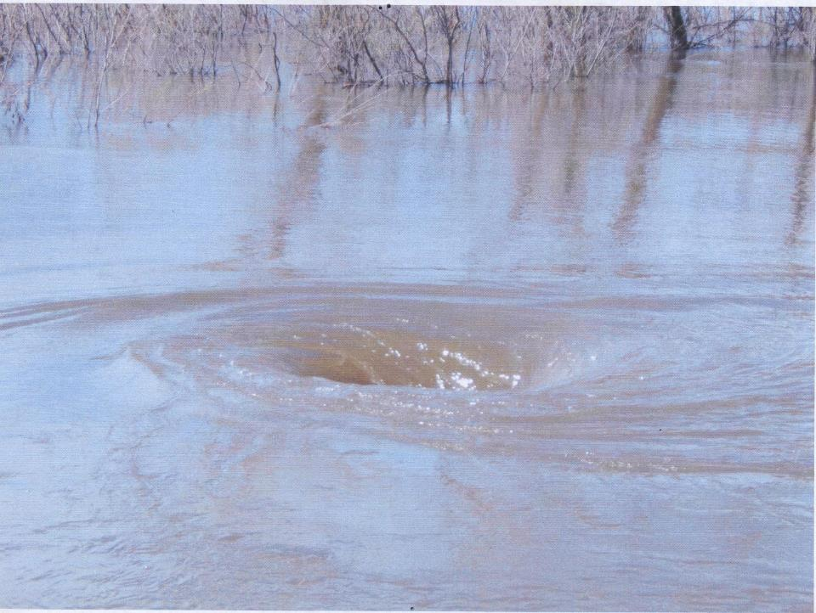
Questions?
Whirlpool in floodplain flow at Minnesota River near Jordan

